Slide 1


Advanced ECG Signal Denoising Using Deep Learning
BJ
by Bilal Javed Goraya

Slide 2
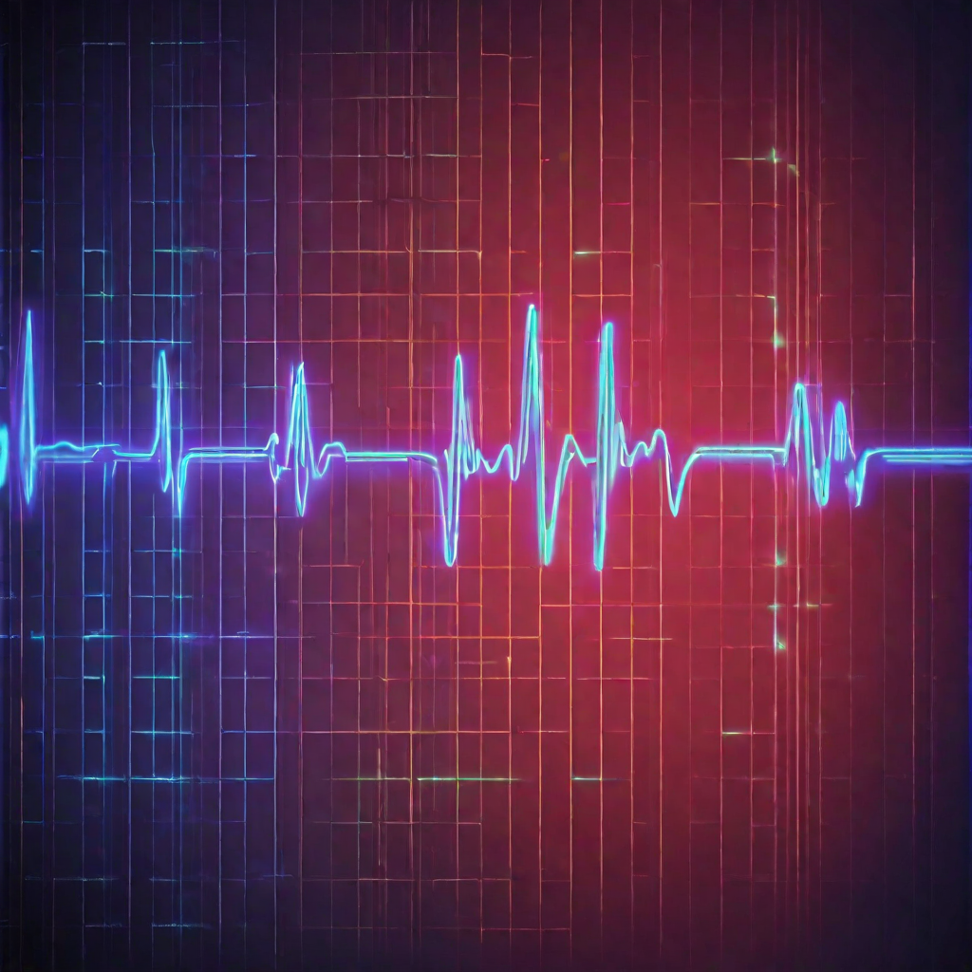
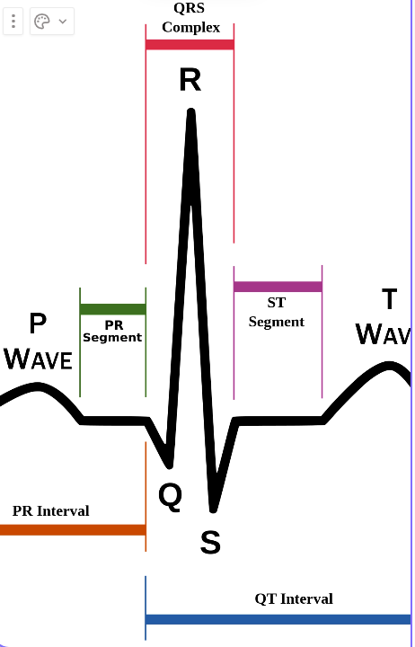
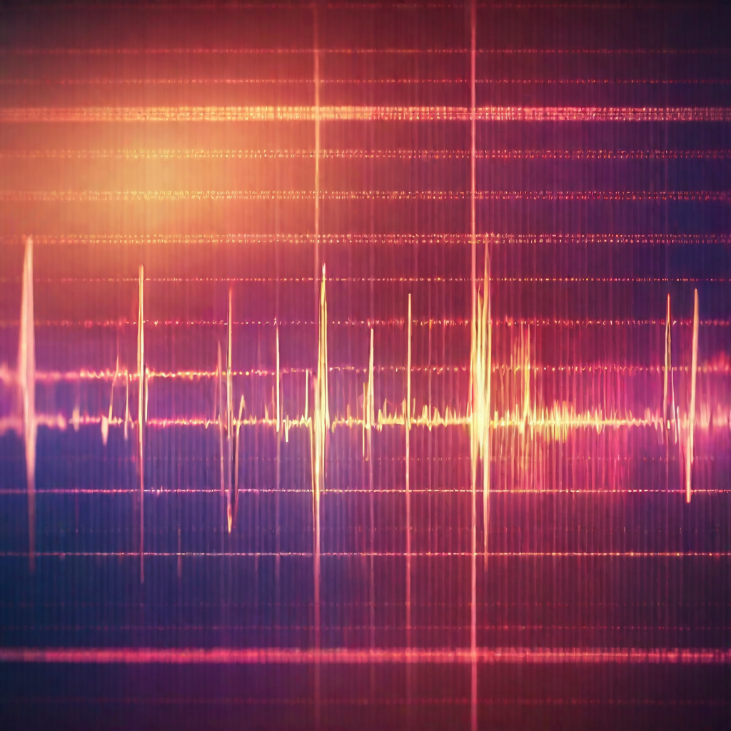
ECG Signal
Electrocardiogram (ECG) is a vital medical diagnostic tool that records the electrical activity of the heart
over a specific period. This non-invasive test involves placing electrodes on the skin to detect and measure
the electrical impulses generated by cardiac-muscle contractions.
Types of Noise in ECG Signals
Baseline Wander
Muscle Artifact
Electromyographic (EMG) Noise
Impact of Noise on ECG Signal Quality
Interference with Diagnosis
Misleading Patterns
Reduced Diagnostic Accuracy
Need for Denoising
Enhanced Diagnostic Accuracy
Improved Signal Quality
Facilitation of Automated Analysis

Slide 3
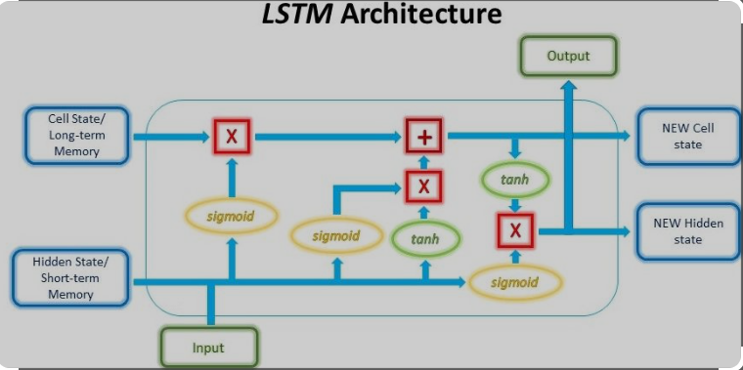
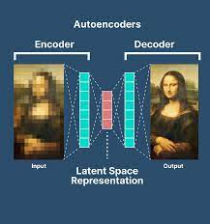
Deep Learning Models
DRNN Architecture
LSTM Layers and Fully Connected Layers:
Long Short-Term Memory (LSTM) layers capture temporal dependencies over multiple time steps.
Fully Connected Layers integrate high-level features for accurate denoising.
Importance of Recurrent Connections:
Recurrent connections enable the model to retain context and memory.
Vital for denoising tasks where understanding temporal patterns is crucial.
How It Works:
Temporal Dependency
LSTM layers process input sequences, capturing dependencies effectively.
Feature Extraction
Extracted features contribute to understanding and denoising complex ECG patterns.
Output Generation
Fully connected layers generate the denoised output, enhancing signal fidelity.
FCN_DAE Architecture
Encoder-Decoder Design
Activation Functions and Batch Normalization
How It Works
Encoding
Latent Representation
Decoding

Slide 4
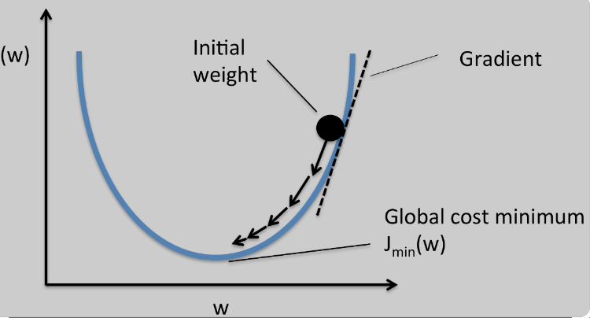
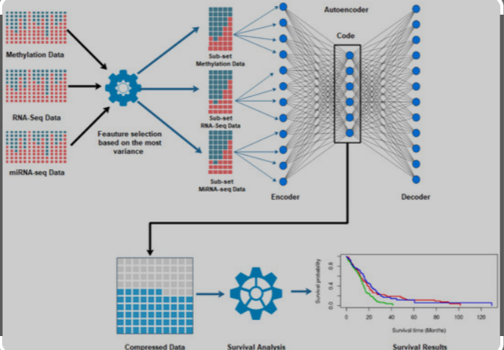
How Each Numerical Method Is Applied
Optimization
Stochastic Gradient Descent (SGD)
Backpropagation
Roots of Equations
Polynomial Interpolation
Signal Alignment
Systems of Linear Algebraic Equations
Linear Regression
Weight Adjustment
Curve Fitting
Autoencoders: These neural networks are inherently curve fitters, learning to encode and decode input data to reconstruct the essential features while filtering out noise.
Non-linear Activation Functions: Neural networks use activation functions like ReLU, which introduce non-linearities, allowing them to capture complex patterns in ECG signals.
Ordinary Differential Equations (ODEs)
Recurrent Neural Networks (RNNs): Modeled after the concept of solving ODEs, RNNs capture temporal dependencies by maintaining hidden states and updating them at each time step.
Long Short-Term Memory (LSTM): A specialized RNN architecture that mitigates the vanishing gradient problem, enabling the network to capture long-term dependencies.

Slide 5

Applications
Biomedical Signal Processing
ECG Denoising: The primary goal of the project is to reduce noise in ECG signals, ensuring a cleaner representation of the underlying cardiac activity. This has direct implications for accurate diagnosis and analysis of heart conditions.
Clinical Diagnosis and Monitoring
Arrhythmia Detection: Clean ECG signals facilitate more accurate detection of arrhythmias and abnormalities in heart rhythm, aiding in the diagnosis of cardiovascular diseases.
Disease Monitoring: Noise-free ECG signals are essential for continuous monitoring of patients with chronic heart conditions, enabling timely intervention in case of anomalies.
Signal Quality Improvement
Data Quality Enhancement: Denoising ECG signals improves the overall quality of data, making it more suitable for various applications, including research studies and clinical trials.
Reducing False Alarms: Cleaner signals can lead to a reduction in false alarms, improving the reliability of automated ECG analysis systems.
Machine Learning in Healthcare:
Feature Extraction: Denoised ECG signals provide a more accurate representation of relevant features, facilitating the extraction of critical information for machine learning models.
Training Data Preparation: High-quality training data is crucial for developing robust machine learning models. The project contributes to creating cleaner datasets for training.
Remote Patient Monitoring:
Telemedicine: In remote patient monitoring scenarios, where ECG signals are transmitted over networks, denoising is vital for ensuring the integrity and accuracy of the transmitted data.

